Slide 1
BED: A New Data Set for EEG-based Biometrics
By: Steven Cao

Slide 2
Why biometric system?
Traditional access control approaches require individuals to remember or possess some information or item that must be presented to the access system.
Problem
Information can be forged or stolen
Information can be hard to remember
Biometrics are an alternative to other more traditional access methods based on keys, ID cards, or passwords.
Why?
Instead of having to present info that can be forged to the access system, it requires the biological and behavioral characteristics of the individual.
Examples
Fingerprint recognition
Face recognition
Iris recognition
Voice recognition

Slide 3
Why EEG-based biometric system?
Electroencephalography (EEG) signals present some major advantages when compared to other biometrics modalities (ex. face, iris, voice)
Resilient to physical injuries
Extremely hard to reproduce
Cannot be furtively captured at a distance

Slide 4
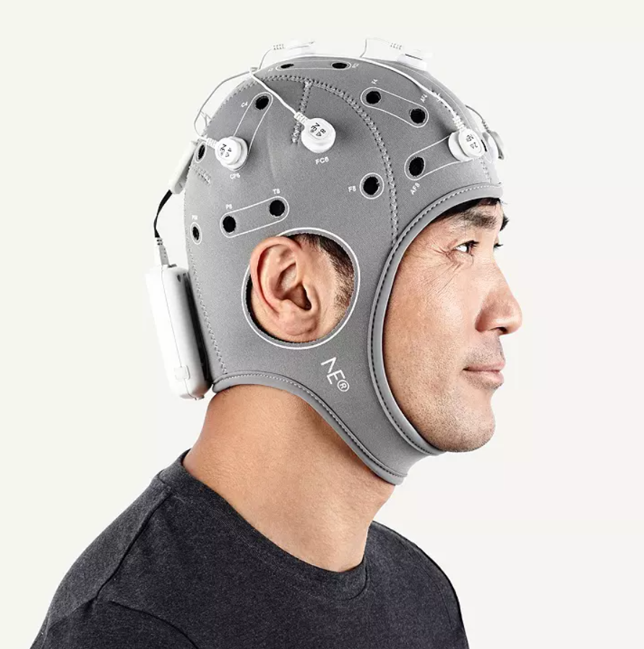
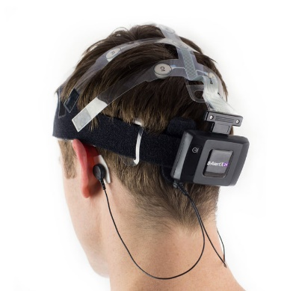
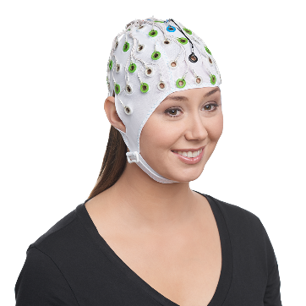
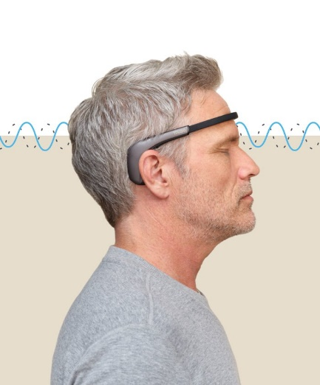
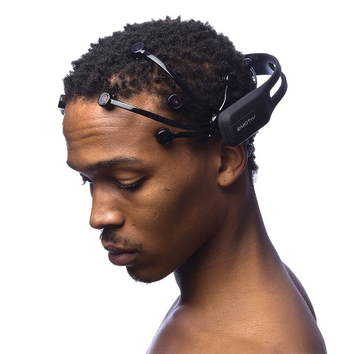
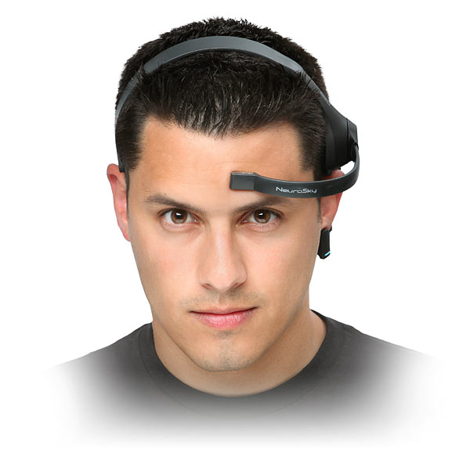
Why consumer-grade devices for EEG-based biometrics?
MEDICAL-GRADE
Medical-grade devices
Too expensive
Tedious preparation needed for acquiring the signals
Consumer-grade devices
Low-cost
Simplify development in real-life scenarios
Brain Vision
Enobio
B-Alert
CONSUMER-GRADE
Emotiv EPOC
MUSE
Mind wave

Slide 5
Previous Datasets Problems
The absence of a public standard benchmark that prevents a fair comparison between methods.
Resulted in:
People using public EEG datasets that were designed for a purpose other than EEG-based biometrics.
Example
University of California, Irvine (UCI): Concieved for alcoholism detection
Visual evoked potentials (VEPs): Conceived for image speech
People creating small private datasets
Little attention towards consumer-grade devices

Slide 6
Why biometric EEG datasets should use different stimuli?
Biometric systems based on EEG signals should consider different stimuli in order to study their potential capabilities.
Why?
The person specific patterns contained in brain signals may strongly depend on many factors, including the task type the subject is performing.
Types of Stimuli
resting state (ex. eyes closed)
cognitive tasks (ex. addition)
sensory stimuli (ex. checkerboard)

Slide 7
Why biometric EEG datasets should have multiple sessions?
Template aging (the increase in error rates caused by time-related changes in the biometric pattern).
Problem
Researchers use data acquired during a single session or have used several sessions but constructed the training and validation sets mixing the samples from all sessions, disregarding the acquisition date.
This results in not examining the permanence of such patterns across time and thus their applicability for practical real-world EEG biometrics systems.
Data acquisition should happen over time, along several sessions.
Why?
To ensure the temporal stability (the stability of the content of reports across time) of the extracted patterns and the proposed solution.

Slide 8
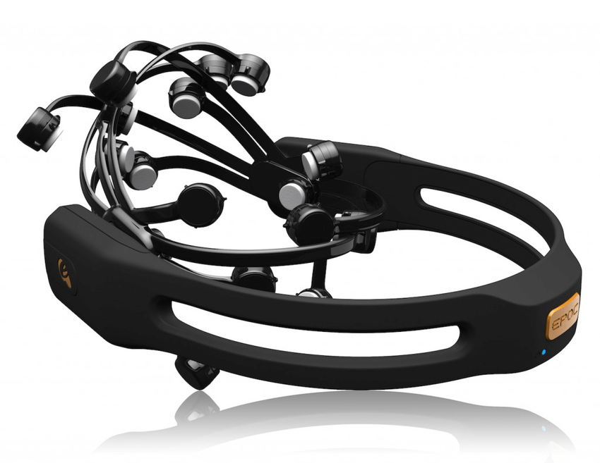
Data Set Design
BED: Biometric EEG Dataset
Uses the Emotiv EPOC+ headset for EEG acquisition
Includes EEG responses from 21 subjects
18 boys
3 girls
Uses 12 different Stimuli
Affective Stimuli
Cognitive Stimuli
Visual Evoked Potentials
Resting State
Contains data from 3 different chronologically disjointed sessions.
Emotiv EPOC wireless EEG headset
Notes:
Talk about the different stimuli: key part of the BED dataset

Slide 9

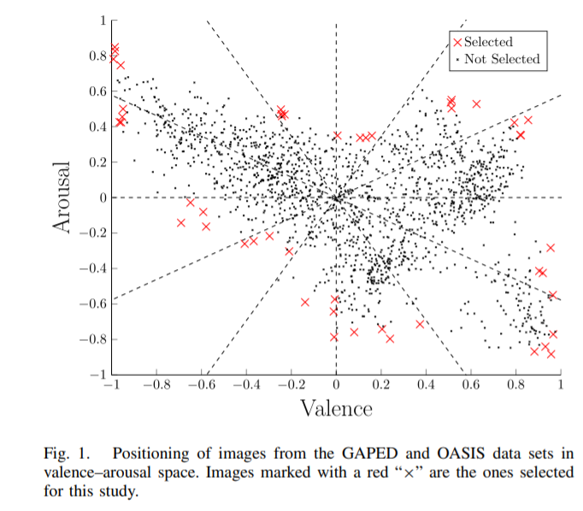
Affective Stimuli
Definition:
A type of stimuli aimed to elicit typical emotional responses
Examples in this study
Images selected to elicit specific emotions (ex. Spiders, bugs)
Used the GAPED and OASIS data sets
Why we use Affective Stimuli?
To facilitate future research on the influence of emotions on EEG-based biometric tasks

Slide 10
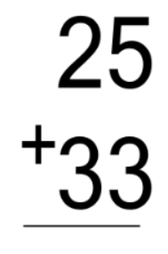
Cognitive Stimuli
Definition
A type of stimuli that involves conscious intellectual activity
Example in this study
Mathematical Computation (two-digit additions)
Why do we use cognitive stimuli?
Generate cognitive imagery-related patterns in the participant
Bring the participant back to a neutral emotion state after been exposed to an affective stimulus.
Check the participants engagement with the experimental process by checking the correctness of their answers.

Slide 11
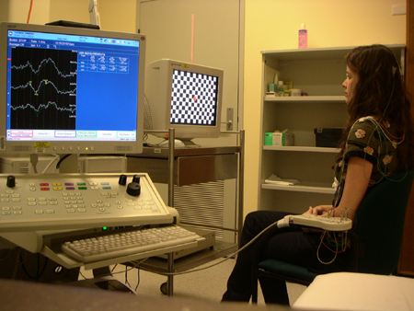
Visual Evoked Potentials
Definition
The electrical potentials due to a brief visual stimuli which can be recorded from the scalp overlying visual cortex.
Examples in this study
Visual Evoked Potentials at 2, 5, 7, 10 Hz - Standard checker-board pattern with pattern reversal
Visual Evoked Potentials at 2, 5, 7, 10 Hz - Flashing with a plain color, set as black
Why do we use visual evoked potentials?
Various researchers have proposed the use of VEP for the extraction of user-specific patterns from EEG signals.
Visual Evoked Potentials through checkerboards

Slide 12
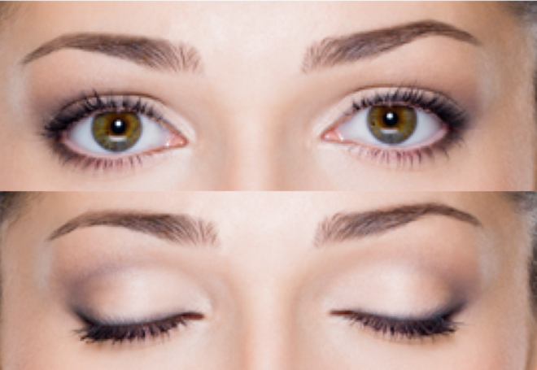
Resting State Stimuli
Definition
The absence of any stimuli or task
Examples in this study
Resting state with eyes closed
Resting state with eyes open
Why do we use Resting State Stimuli?
It has been largely adopted due to its simplicity

Slide 13
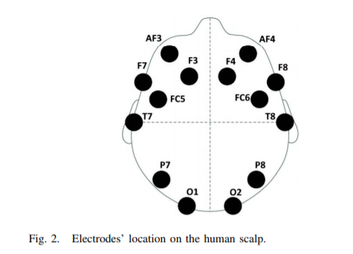
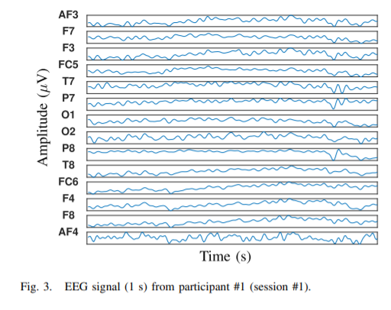
Signal Acquisition
Device used for EEG acquisition
The Emotiv EPOC+ system
Low-cost EEG capturing device
Equipped with 16 contact sensors, fixed on flexible plastic arms that are placed against the scalp of the user.
Fourteen of the contacts
AF3, F7, F3, FC5, T7, P7, O1, O2, P8, T8, FC6, F4, F8, and AF4 locations of the modified combinatorial nomenclature (MCN)
Two contact sensors
M1 and M2 mastoid locations for reference.
Sampling frequency
14-channel EEG signals were captured at a sampling frequency of 256 Hz using the Emotiv EPOC+ [60] wireless EEG headset.
Environment setting
Controlled illumination
Isolated from sources of noise or distraction.
Emotiv EPOC wireless EEG headset

Slide 14
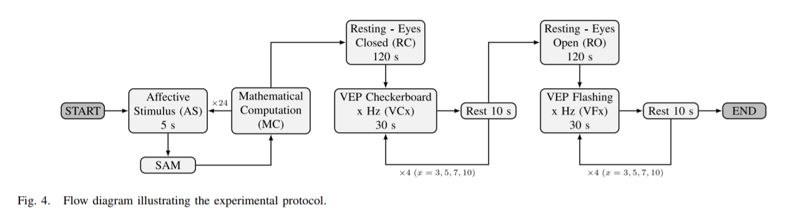
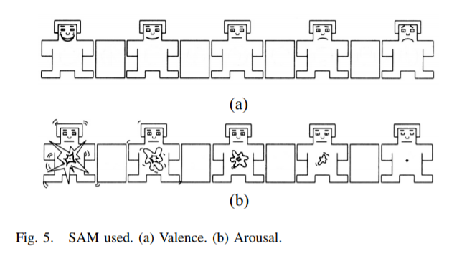
Acquisition Protocol
Notes:
I will not talk much about the acquisition protocol in these slides. If you want to see the full outline of the protocol, then read the paper

Slide 15
Self-Assessment Manikin (SAM)
Definition
The Self-Assessment Manikin (SAM) is a non-verbal pictorial assessment technique that directly measures the pleasure, arousal, and dominance associated with a person's affective reaction to a wide variety of stimuli.
What are we measuring?
Valence: describes the extent to which an emotion is positive or negative
Arousal: describes the intensity of the associated emotional state.

Slide 16
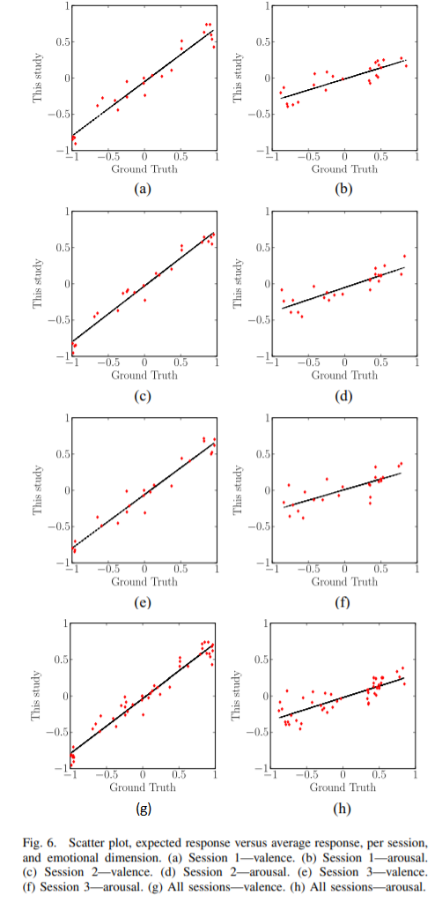
Analysis of the Participant’s responses to the SAM
Results (correlation with the expected answer per subject
The valence dimension shows pretty high average correlation scores of ρ = {0.8231, 0.8506, 0.8507} for the first, second, and third session, respectively.
The arousal dimension presents significantly lower average correlation scores (ρ = {0.3701, 0.4183, 0.3299}).
Conclusions
These figures show that the arousal scale is far more subjective than the valence one, and ratings may have a stronger dependency on the subjects’ background, thus showing a higher variance.

Slide 17
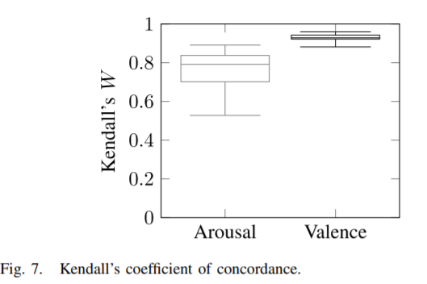
Analysis of the Agreement Between Sessions
Results
For valence, a median Kendall’s W = 0.9285 (p-value << 0.05) was obtained across participants
For arousal, a median Kendall’s W = 0.7918 (p-value < 0.05 in all but five subjects).
Conclusions
These values show a very high intersession agreement for valence ratings and a moderate one for arousal ratings.

Slide 18
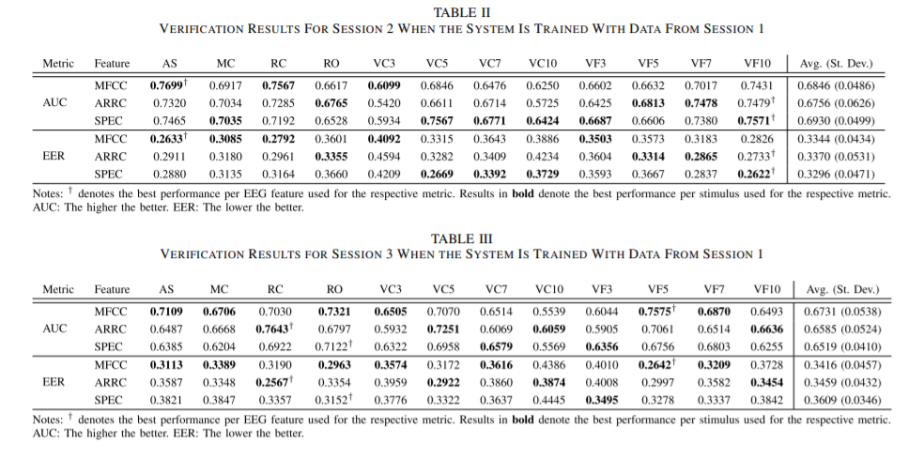
Baseline Results for Subject Verification Using the BED dataset
Evaluation process
Data acquired during one session for enrolment, and data acquired at another later session to test the verification performance.
Evaluation process for the performance degradation due to time aging
Trained the subject models with data from the first session and independently tested them by using data from the second and third sessions.
Patterns
The average performance along all different types of stimuli decreases consistently with time
The stimuli, affective image stimuli (AS) and resting state with the eyes closed (RC) seem to perform slightly better compared to other stimuli for verification performance.
Tables II and III show the subject verification results for each stimulus (columns) and EEG feature (rows).

Slide 19
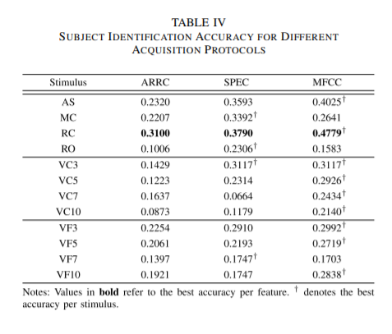
Baseline Results for Subject Identification Using the BED dataset
Method
Data from sessions 1 and 2 were used for training and data from session 3 were used to test the trained models.
Conclusions
MFCC features provide the best performance for the majority of stimuli. This is true for all cases except MC, RO, and VF7, for which the SPEC features provided the highest accuracy.
The highest identification accuracy for each type of feature (MFCC, ARRC, and SPEC) was always achieved for the resting state with eyes closed (RC) stimulus

